Slide 1



취뽀하자!
AWS 클라우드 인프라 설계
Make it possible

Slide 2
















Groups 1/5
*
AWS Cloud
AWS Cloud
Region
Availability Zone
Security group
Auto Scaling group
Virtual private cloud (VPC)
Private subnet
Public subnet
Server contents
Corporate
data center
EC2 instance contents
Spot Fleet
AWS account
AWS IoT Greengrass Deployment
AWS IoT Greengrass
Elastic Beanstalk container
AWS Step Functions workflow
Generic group
Generic group
*
In certain AWS Regions (e.g., China), AWS does not own the rights for the logo using the letters “AWS.” Per our guidelines, use the group with the AWS logo except in Regions where the AWS logo cannot be used. You may use the group with the cloud icon in those cases.

Slide 3
Arrows 3/5

Slide 4
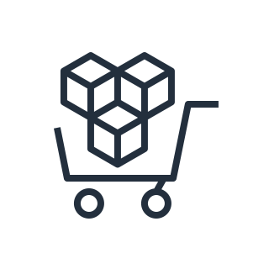




















General Icons 5/5
AWS Marketplace
Multimedia
Programming language
Source code
Logs
JSON script
Document
Documents
Folder
Folders
Data table
Magnifying glass
Generic application
Email
Metrics, Data visualization
Git repository
AWS Management Console
Camera
Question
Gear
Recover

Slide 5



























General Icons 4/5
AWS Marketplace
Client
Mobile client
Disk
Server
Servers
Tape storage
Database
Cold storage
Data stream
Internet
Internet alt1
Internet alt2
Globe
Office building
Firewall
SAML token
SSL padlock
Credentials
Shield
Alert
Toolkit
SDK
User
Authenticated user
Users
Forums
Chat

Slide 6


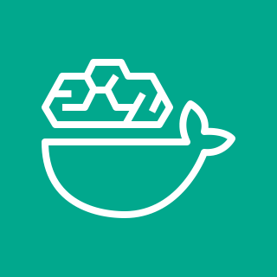



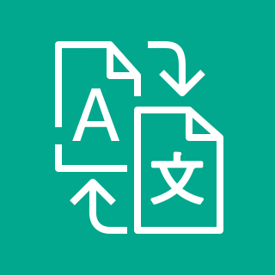







IT Solution: k-port Company(인프라 구성도)
Only access
AWS Cloud
3 Tier (Web , WAS , DB)
AWS Deep Learning Containers
Active - Active
Users
자사 AI 번역 솔루션
Load Balancing
Amazon SNS
standby
HTTP notification
Email notification
Failover
Alarm
Amazon CloudWatch
(Amazon S3)
Logs
administrator

Slide 7










AWS 인프라 구성도
Internet
CloudFront
Region: USA
……………..
Amazon Route 53
Edge location
AWS Cloud
Region: Seoul
Internet gateway
Amazon S3
Virtual private cloud (VPC)
Availability Zone 1
Availability Zone 2
Public subnet
Private subnet
ELB
Private subnet
Public subnet
NAT gateway
ASG
EC2 (Web)
EC2 (Web)
NAT gateway
Private subnet
Private subnet
ELB or SQS
Private subnet
Private subnet
Amazon RDS
(Primaty)
ASG
Amazon RDS
(Standby)
EC2 (App)
EC2 (App)
동기식 자동 복제

Slide 8
사용자 서비스
관리자 서비스
Internet
KT GIGA office
KT managed
Firewall
3 Tier (Web , WAS , DB)
Active - Active
standby

Slide 9
사용자 서비스
관리자 서비스
Internet
KT GIGA office
KT managed
Firewall
3 Tier (Web , WAS , DB)
Active - Active
standby

